Slide 1
Preliminary building damage mapping following the 2016 Kumamoto Mw7.1 Earthquakes using PALSAR-2 image
Yanbing Bai
Bruno Adriano
Erick Mas
Hideomi Gokon (Univ. of Tokyo)
Shunichi Koshimura

Slide 2
BACKGROUND
A M_{w}6.4 earthquake occurred on April 14, 2016 21:32 (JST) in Kumamoto City, Kyushu Island, Japan. This event was followed by two big aftershocks of M_{w}6.4 on April 15, 2016 00:09 (JST) and Mw7.1 on April 16, 2016 01:30 (JST). It was reported that the latest event generated most of the damage in Kumamoto city and surroundings⁽¹⁾.
The ReGiD Lab. From IRIDeS, Tohoku University in collaboration with JAXA and the University of Tokyo conducted a preliminary building damage estimation using a model that is being developed using only post-event Synthetic Aperture Radar (SAR) images from Katmandu city taken after the 2015 Nepal Earthquake (Bai et al., 2016).
In this preliminary damage assessment, we employed a post-event SAR image captured after the main shock of Mw 7.1 (third significant earthquake) on April 17, 2016. The image from Kumamoto city was acquired by the Advanced Land Observing Satellite 2 (ALOS-2) / L-band Synthetic Aperture Radar (PALSAR-2)
The training data used in the damage estimation model is from Nepal earthquake and they are probably different.
⁽¹⁾http://irides.tohoku.ac.jp/topics_disaster/2016kumamoto-eq.html

Slide 3
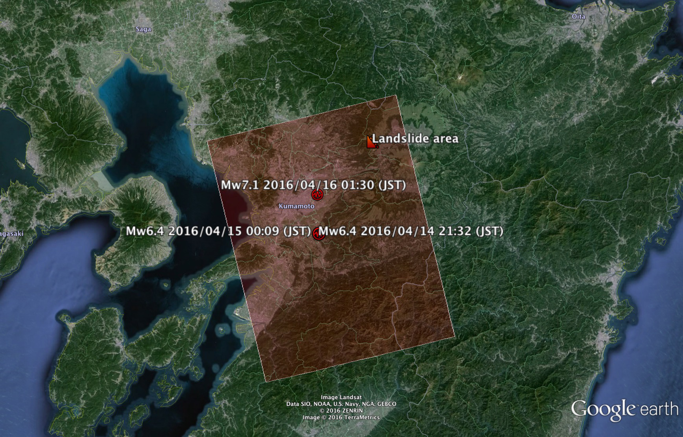
ALOS-2/PALSAR-2 coverage
There were 3 big earthquakes starting on April 14.
The Mw7.1 generated most of the building damage, and a landslide to the northeast of Kumamoto city.
Acquisition time:
2016/04/17 00:04 (JST)

Slide 4
Methodology for Damage Estimation
Pre-processing
The PALSAR-2 data was converted from digital number to backscattering coefficient (sigma-naught [dB]) using the equation provided by JAXA website⁽¹⁾. Then, the PALSAR-2 data was filtered using a Lee filter (Lee 1980) using a 3 x 3 pixel window.
Damage estimation
We calculated 16 texture parameter based on the Grey-Level Co-occurrence Matrix (Haralick et al., 1973), Gray histogram properties (Anys et al., 1994), and the HH-polarization information.
Using the building footprint downloaded from the Geospatial Information Authority of Japan website⁽²⁾, the average value of each texture parameter is calculated for each building.
Finally, using as training sample the damage observed after the 2015 Nepal earthquake, a random forest algorithm (Breiman et al., 2001) was used to classify the building damage into two categories in Kumamoto city.
⁽¹⁾http://www.eorc.jaxa.jp
⁽²⁾http://www.gsi.go.jp

Slide 5
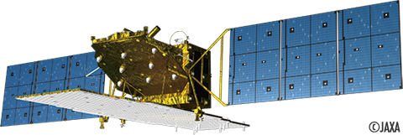
PALSAR-2 Post-event Image (2016/04/17)
Sigma-naught (σ°) image
Assessed Area
Azimuth
range
Acquisition mode: StripMap (SM1)
Ascending Orbit direction (azimuth)
Right side observation (range)
HH-polarization
Data format Level 1.5
Pixel Spacing: 2.5 m
σ°[dB]
+10
-40

Slide 6
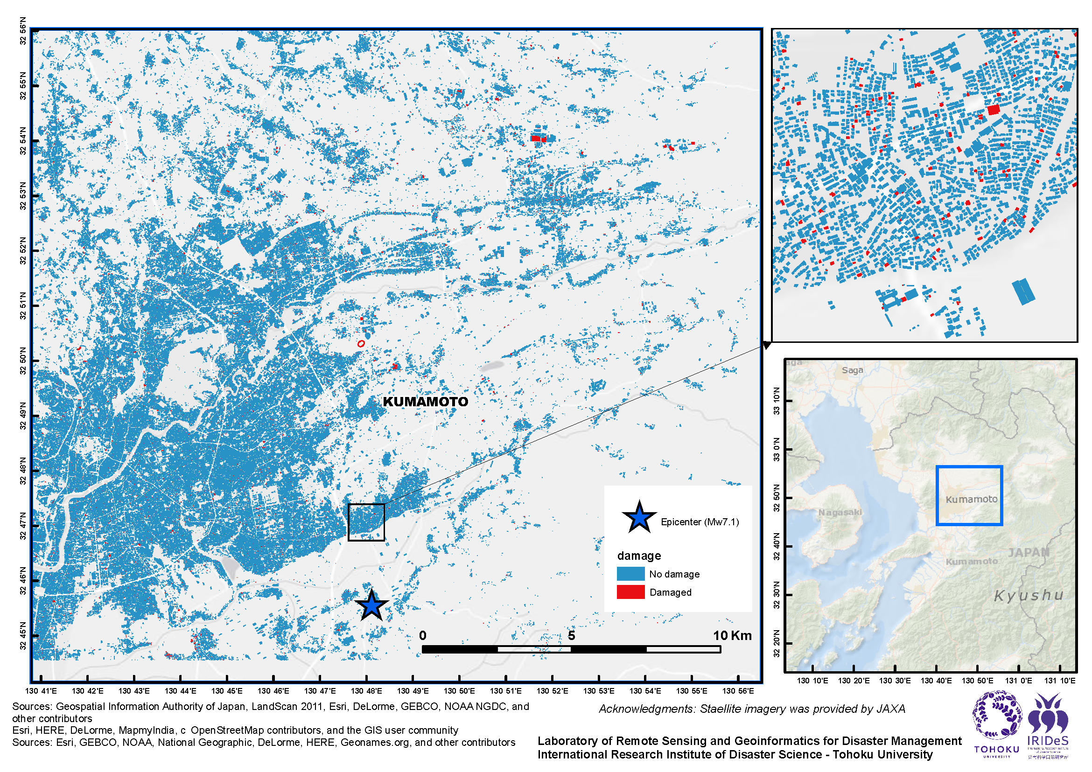
Preliminary Building Damage Mapping
The training data used in the damage estimation model is from Nepal earthquake and they are probably different.

Slide 7
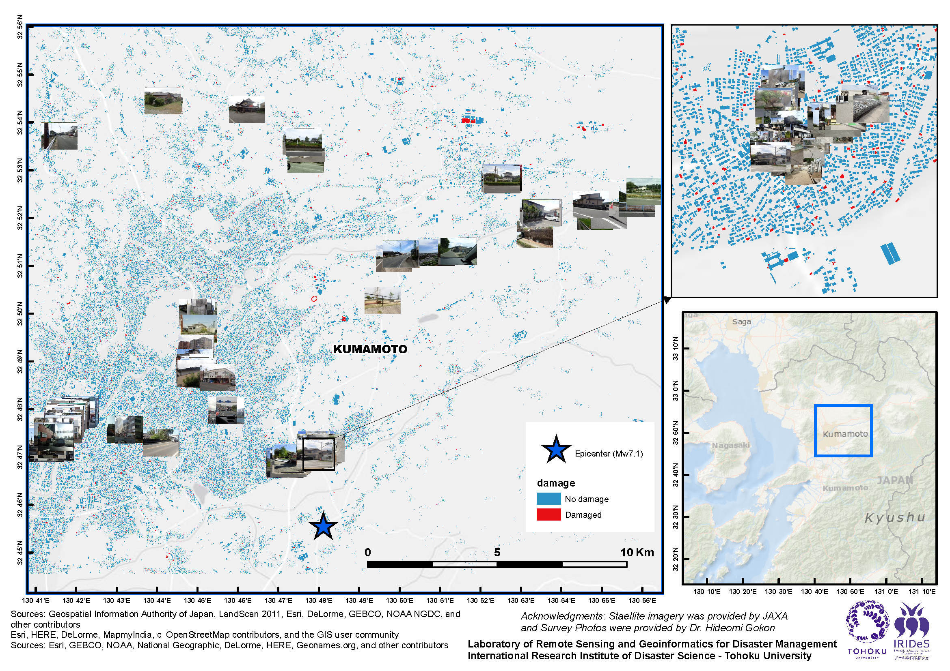
Preliminary Building Damage Mapping

Slide 8
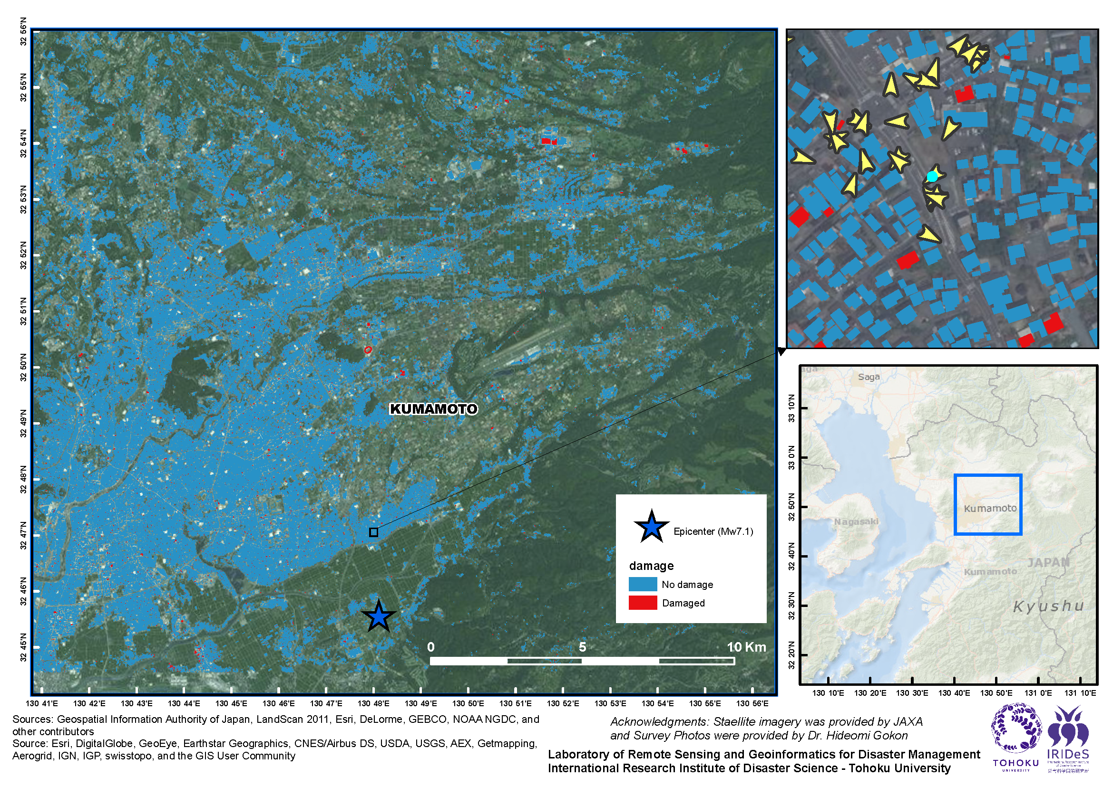
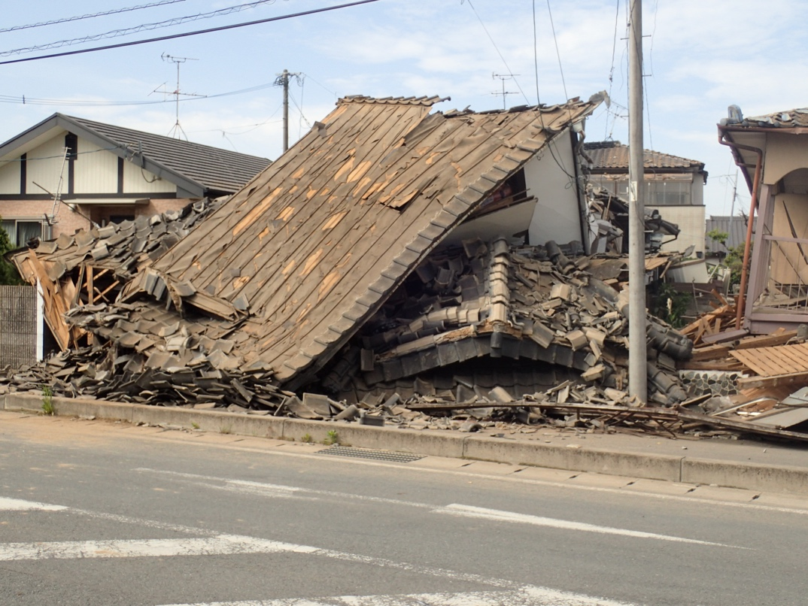
Preliminary Building Damage Mapping

Slide 9
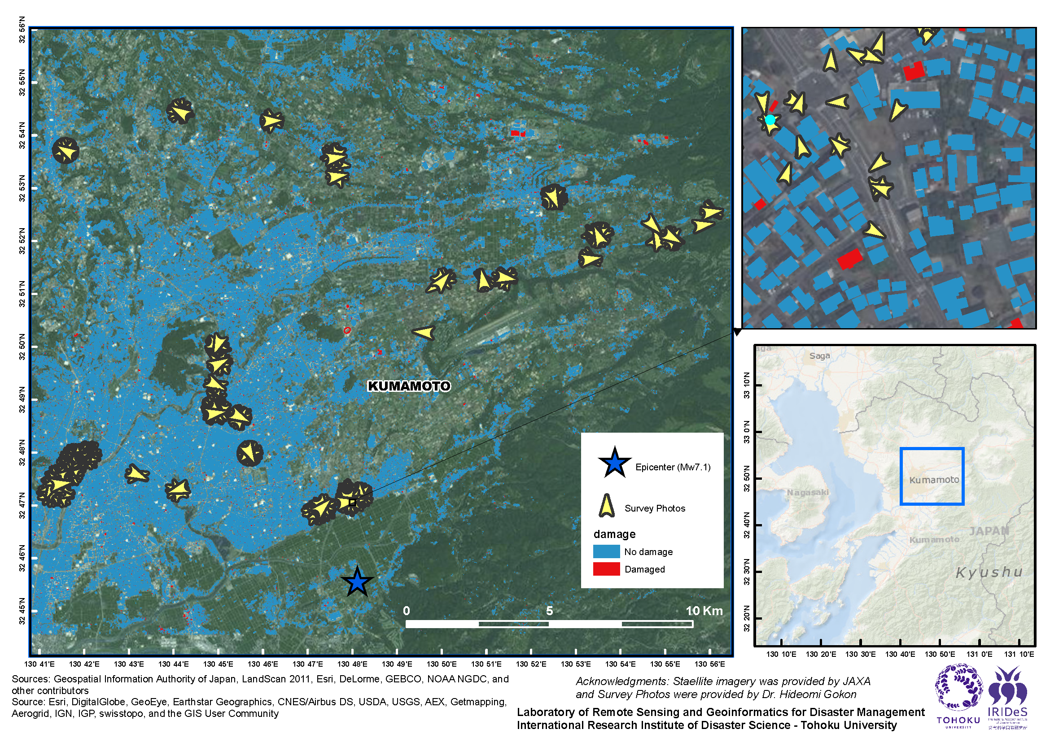
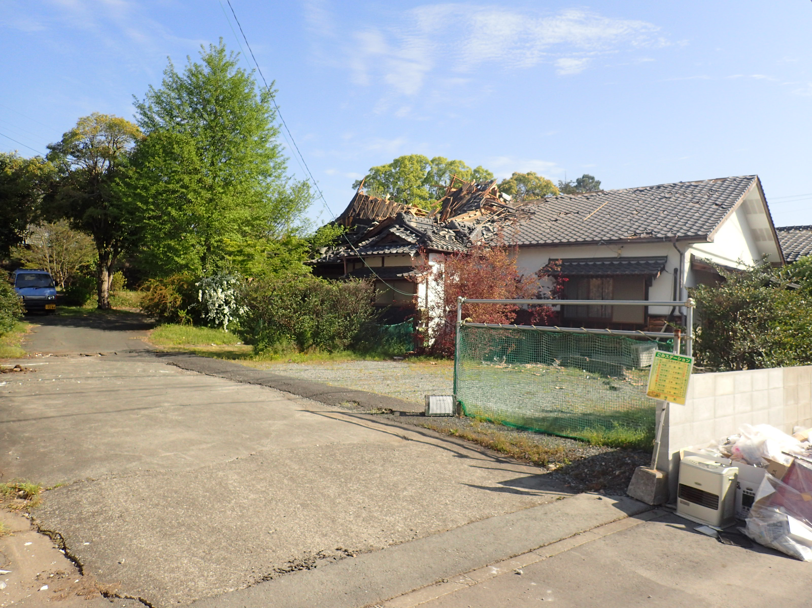
Preliminary Building Damage Mapping

Slide 10
Final Comments
According to the damage estimation, the damage is scattered throughout the Kumamoto city.
To verify the estimation, survey photos were used as ground truth data (GTD). While some locations where the model detected damage agree with the GTD, other buildings that were actually damaged were not detected by the model.
Acknowledgement
ALOS-2/PALSAR-2 image is owned by JAXA, and the dataset was provided by JAXA. Survey photos were provided by Dr. Hideomi Gokon from the University of Tokyo.

